Slide 1
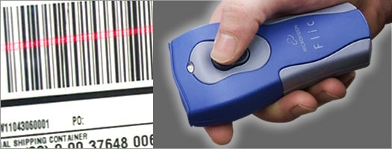
Inventory Management and
Bar-code Implementation
Presentation Title Goes Here
…presentation subtitle.
Submitted To:
Er.Rajbir Singh Cheema
(H.O.D of IT)
Submitted by:
Harminder kaur(100470825389)
Navdeep kaur(100470825404)

Slide 2
Barcode Inventory Management System
Generate Barcodes & Print Barcodes
Apply barcode on IN or OUT items
Take snapshot by Camera
Scan barcodes on IN OUT and match records

Slide 3
Generating & Printing barcode
Unique barcode for each Item
Image of item is scanned and stored
Print Barcode and attach on item

Slide 4

Types of Inventories (Cont’d)
Replacement parts, tools, & supplies
Goods-in-transit to Department or customers

Slide 5

Challenge??

Slide 6
The Problems
Detailed study of Inventory model is required
Inventory movement is monitored and tracked

Slide 7
The Problems
To help security staff to easily locate inventory
To stop fraud
To smoothly transfer ownership of products.

Slide 8
Computerized Management

Slide 9
Effective Inventory Management
A system to keep track of inventory
Easy Management
Knowledge of product location
A classification system

Slide 10
Basic Inventory Management Problems
Manual Entry Required
Time consuming
No location track
Not easy to search Information

Slide 11
Unique Feature
Universal Bar Code - Bar code
printed on a label that has
information about the item
to which it is attached
0
214800 232087768

Slide 12
Unique Feature
One time information entry is required. Then for any operation we have to just scan
0
214800 232087768

Slide 13






Barcode basics:
Type of barcodes
1D barcode
  UPC
  Code 39
  Code 128
  etc
2D barcode
  PDF 417
  MaxiCode
  etc

Slide 14
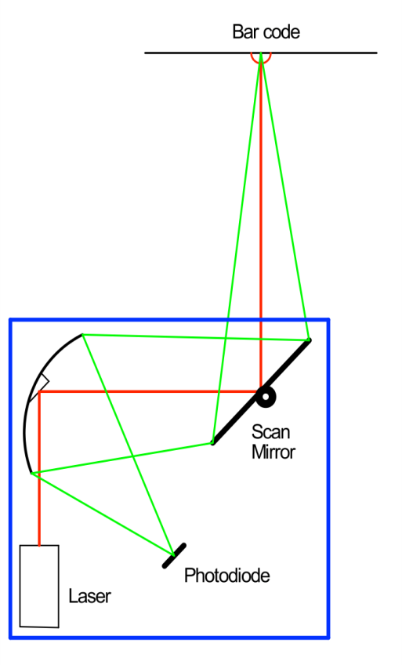

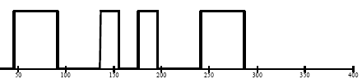
How a laser scanner works
A laser spot is scanned across the bar code symbol that is to be read.
The light reflected from the symbol is directed to a photodiode where it is converted from optical energy to electrical current.
The signal is processed through both hardware and software, and the information it carries is extracted.
Signal Processing: Hardware and Software
Notes:
88H-0000UB-0TV

Slide 15
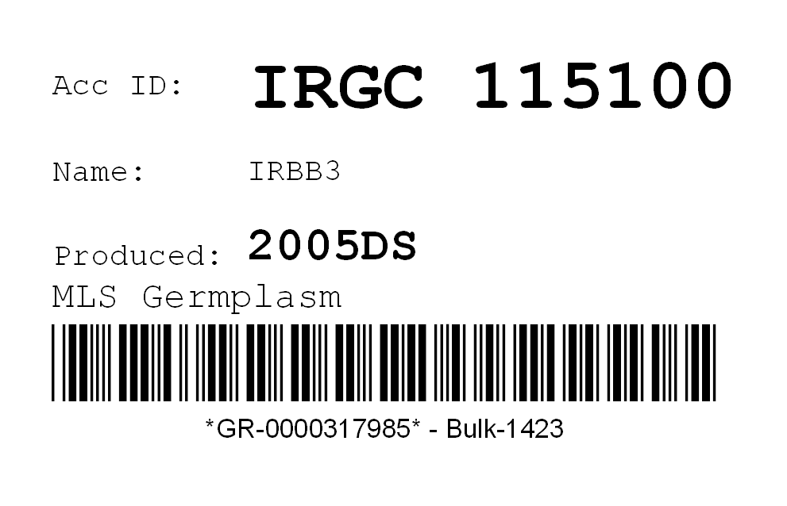
Barcode Label

Slide 16
Summary
Barcode system are much efficient and make the whole management a lot simpler.

Slide 17
Technologies Used
Advance JAVA (J2EE)(Servlets, Jquery, JavaScript)
Mysql:- Online Server Databases
Sqlite :-Local database for mobile Application
Apache Tomcat Server to run web-Application locally
Barcode Scanners

Slide 18
Mobile Application
A mobile application can be used instead of Barcode Scanner for remote barcode scanning

Slide 19
Snapshots

Slide 20
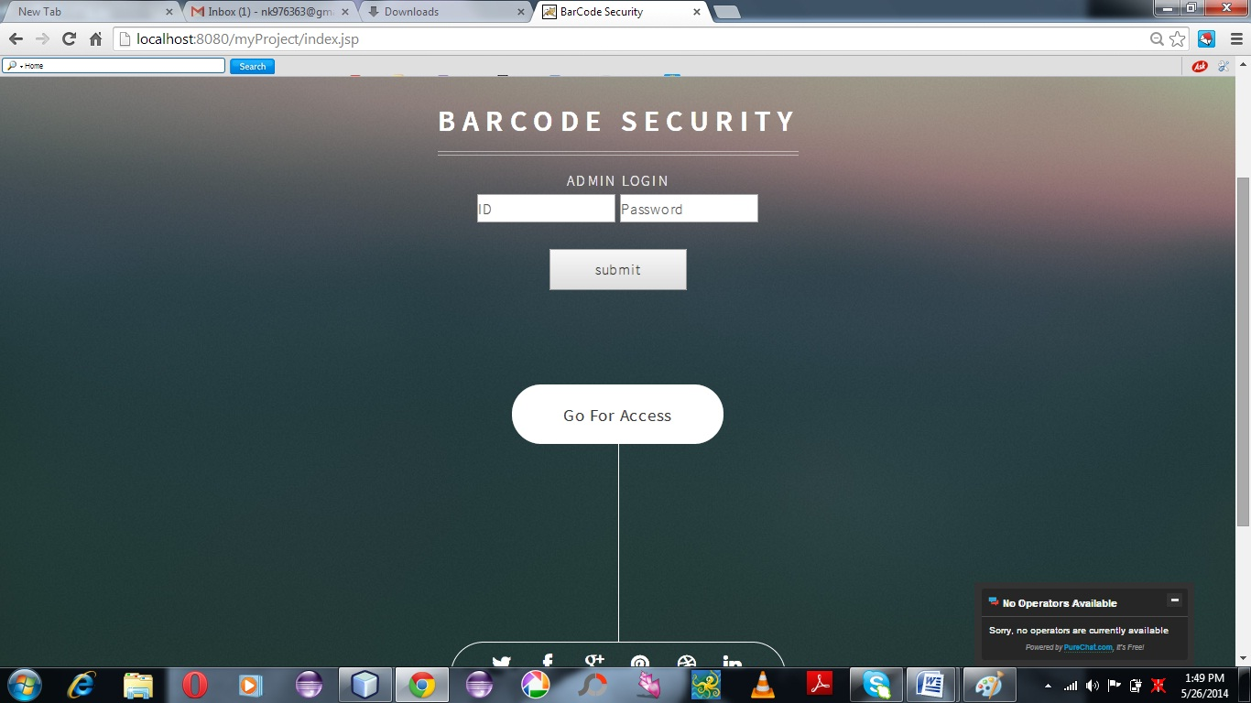


Slide 21
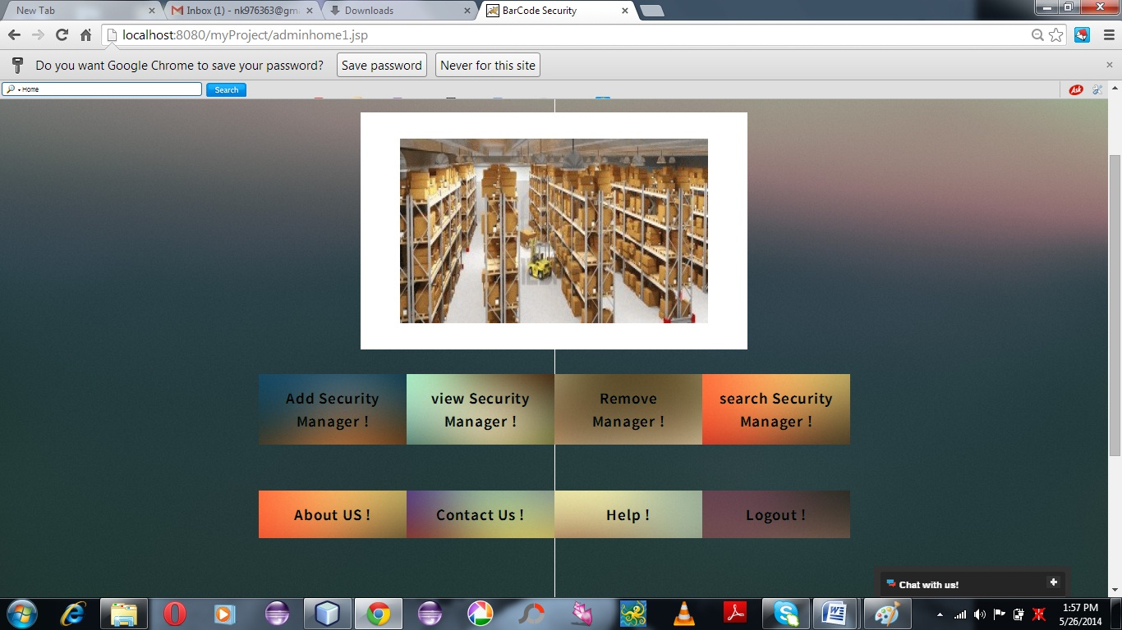
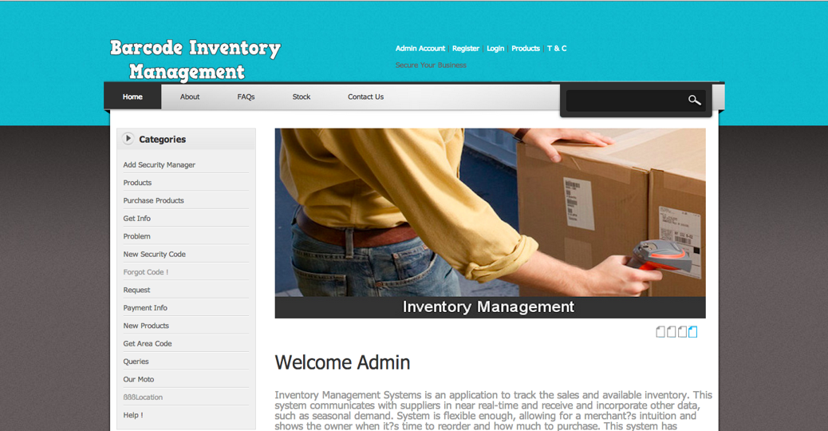

Slide 22
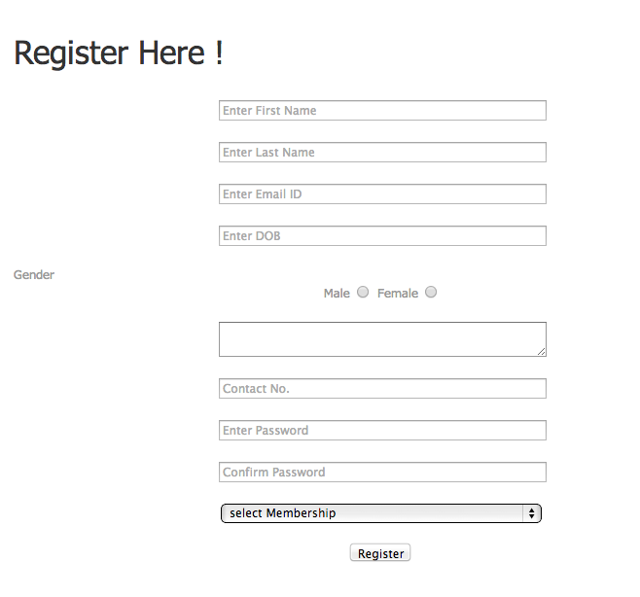
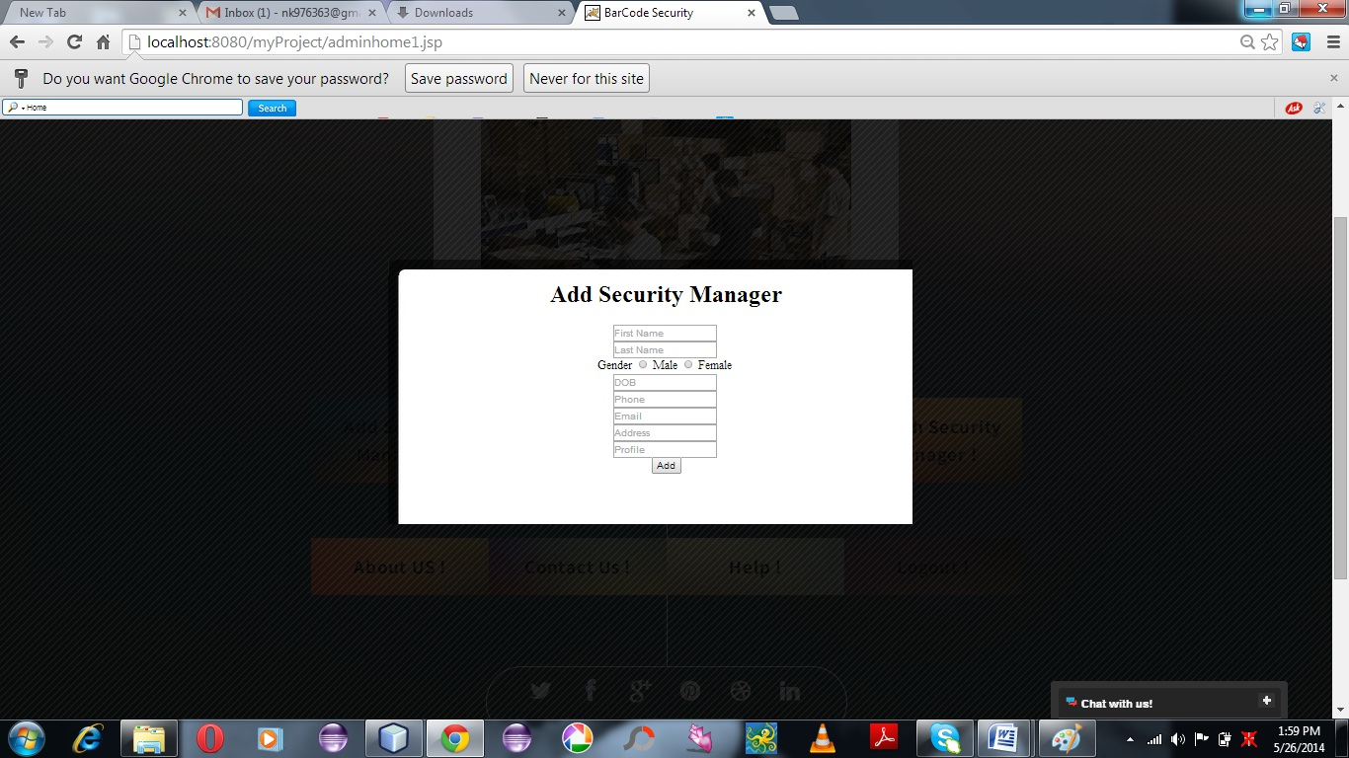

Slide 23
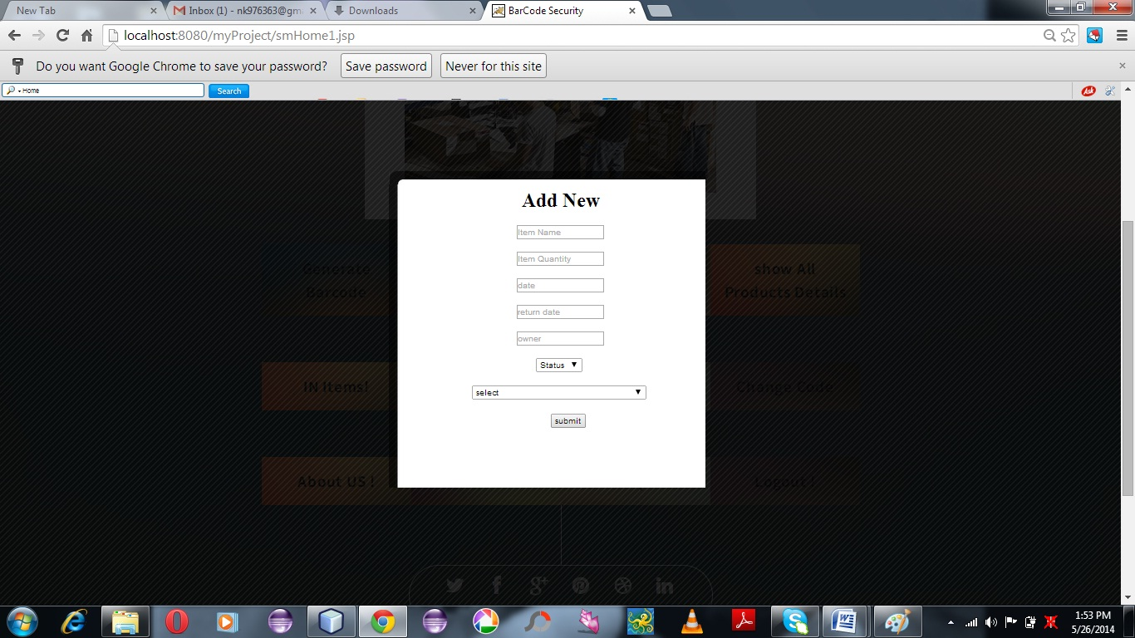
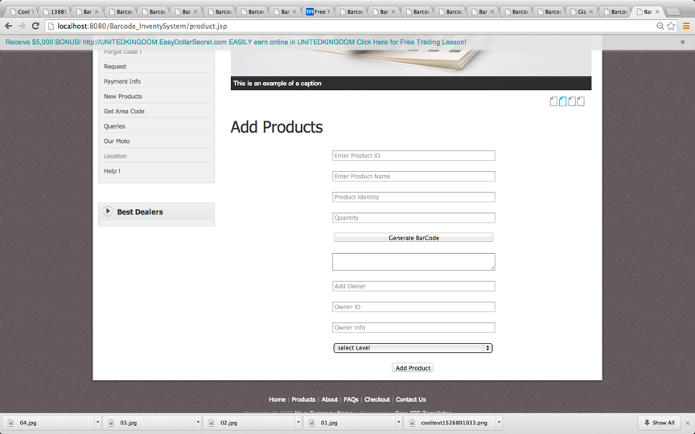

Slide 24

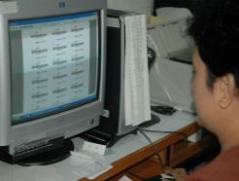

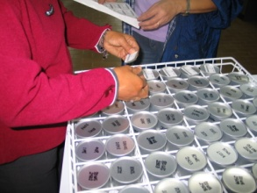
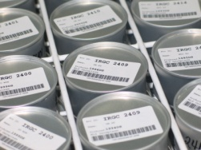
Thank you
Presentation Title Goes Here
…presentation subtitle.

